Slide 1
Datasets Comparison
Supervised by prof. Ahmed Said

Slide 2
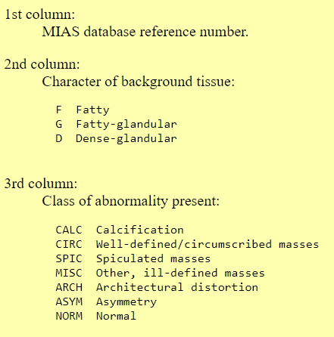
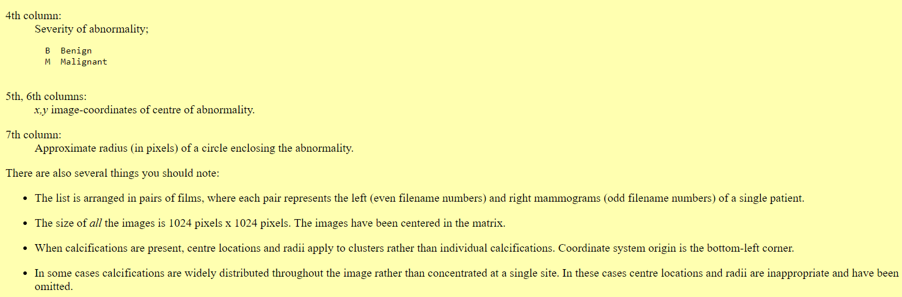
Mini-MIAS Dataset
The data set consist of:
62 benign, 207 NORM ,43 malignant

Slide 3
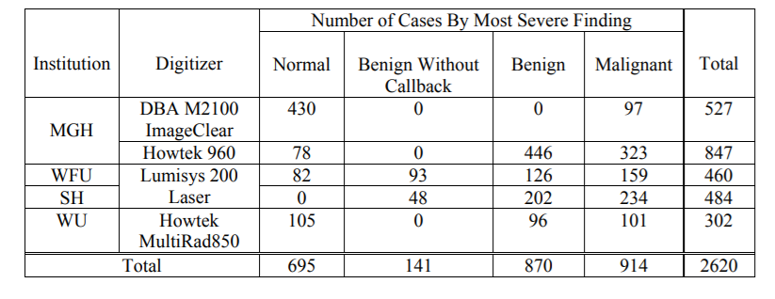
CBIS-DDSM
This CBIS-DDSM (Curated Breast Imaging Subset of DDSM) is an updated and standardized version of the Digital Database for Screening Mammography (DDSM).
The DDSM is a database of 2,620 scanned film mammography studies.
It contains normal, benign, and malignant cases with verified pathology information.
It is in JPG format.

Slide 4
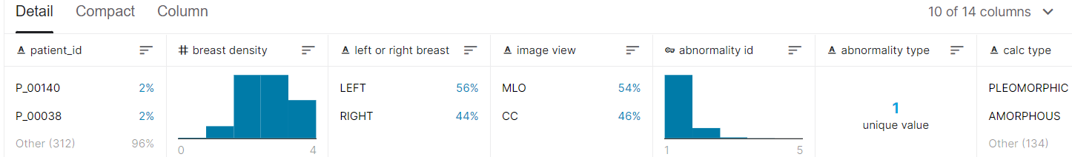
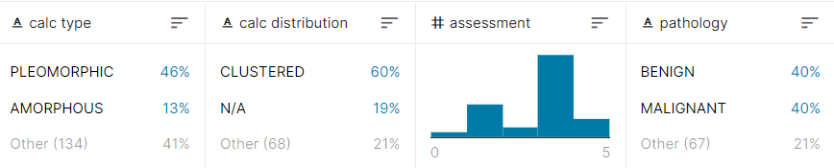
CBIS-DDSM
1-calc_case_description_test_set.csv

Slide 5
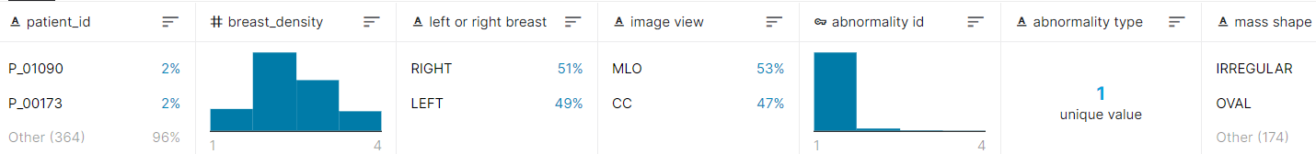
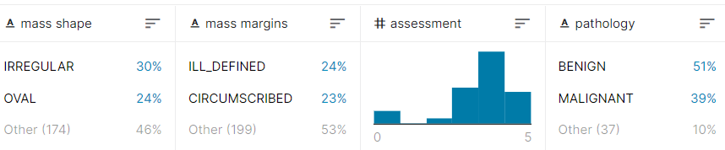
CBIS-DDSM
2-mass_case_description_test_set.csv

Slide 6
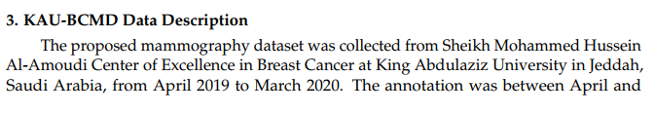
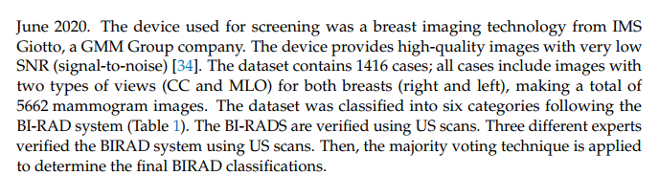
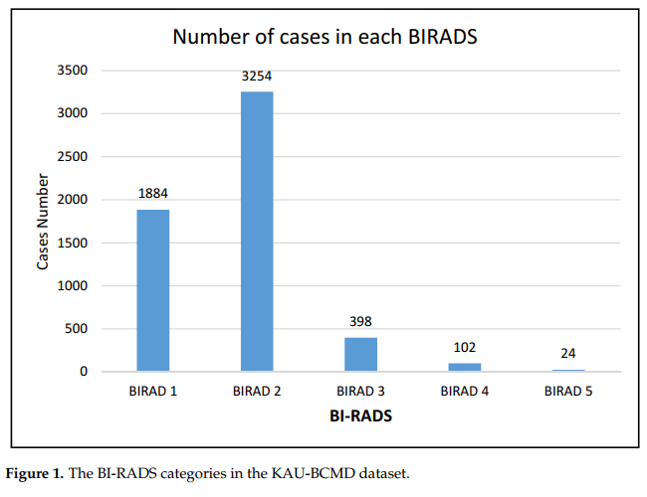
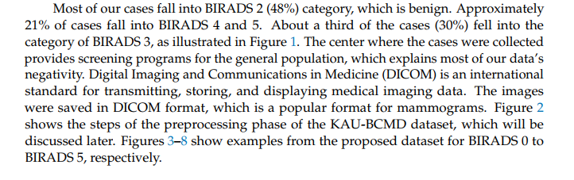
King Abdulaziz University Mammogram Dataset

Slide 7
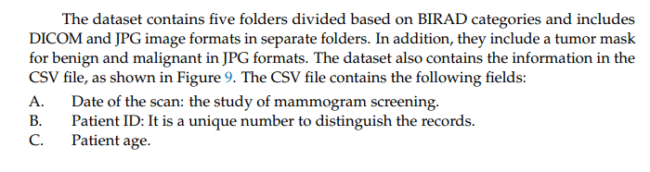
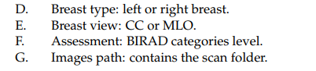
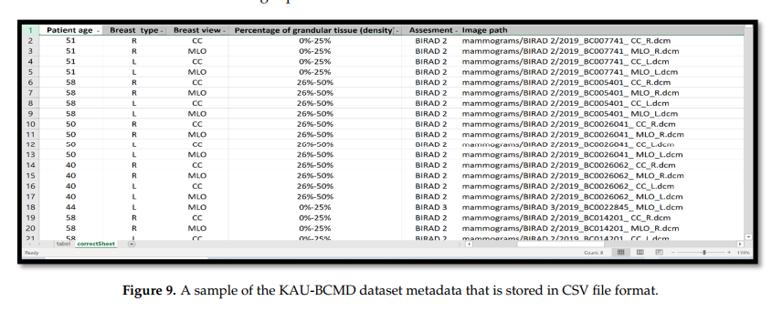
King Abdulaziz University Mammogram Dataset

